Slide 1

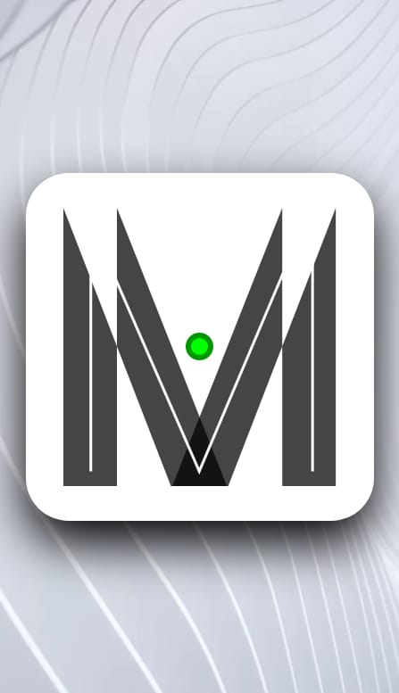
DELHI HACKS HACKATHON 2020
PROJECT: MEDIQ
TEAM: LOCKED-DOWN CODERS

Slide 2

ABOUT THE PROJECT
Our project is about how medicine boxes have very important information written very illegibly behind the box. Since a majority of older people use medication and might not be able to read it properly, we thought we could build an app which scans the unique QR code on each box, which clearly and simply explains the date of manufacturing and dosage . The app isn't geared towards AI providing healthcare, but making the medical information more legible . The app also focuses on improving it with online health medication and dosage details from certified doctors. This app would be of great use to people having problems with medications at any point of time.

Slide 3
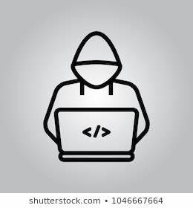
OUR TEAM
Vedeesh Bali
Abhishek Rautela
UI and logo designer
UI and logo designer
Karan Kartikeya
&
Shivansh Sinha
Android developers

Slide 4
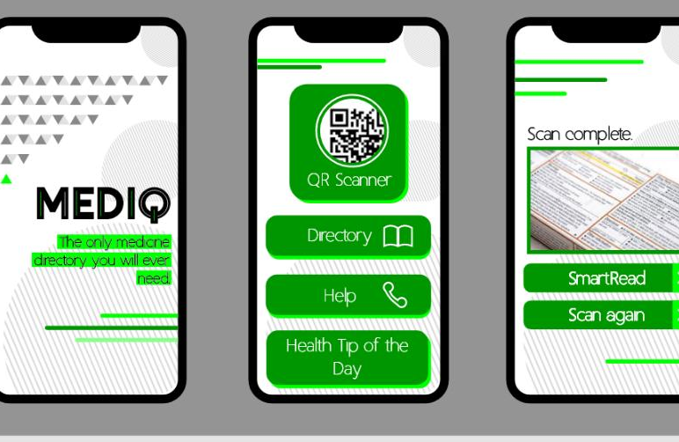
PRODUCT
SNEAK PEEK

